Slide 1
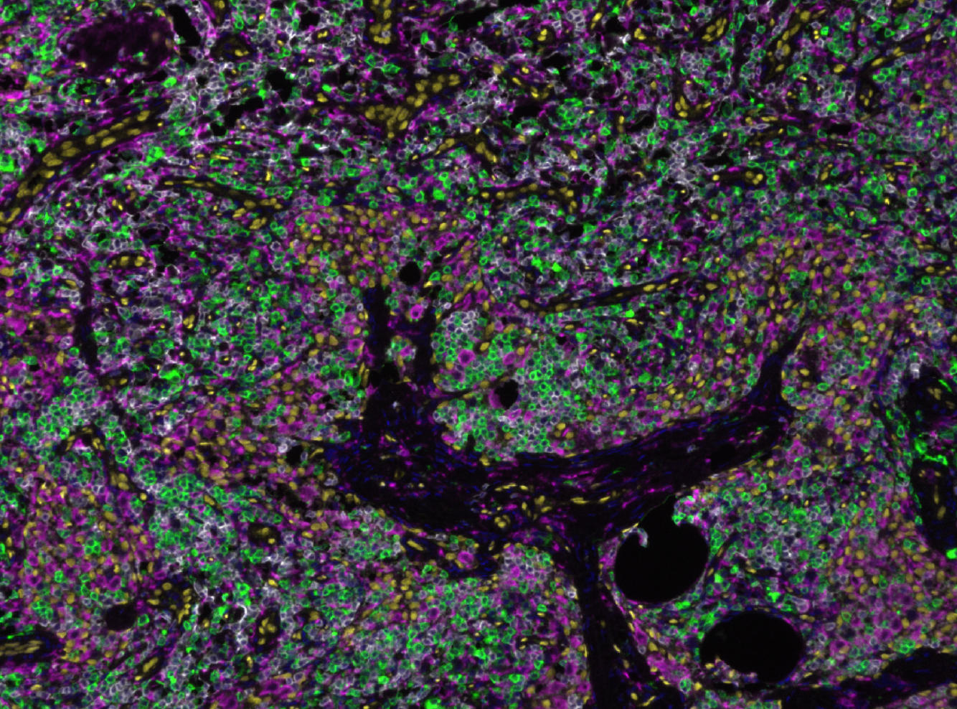
inForm QC
How to ensure accurate results from pretty pictures

Slide 2
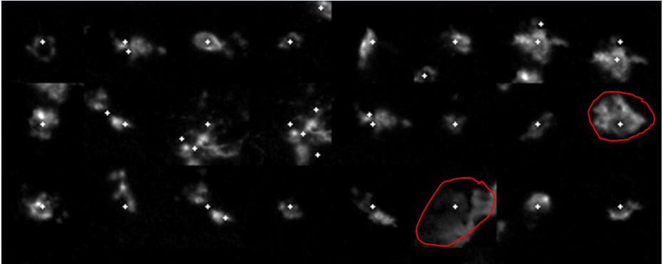
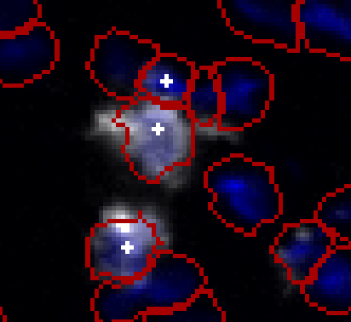
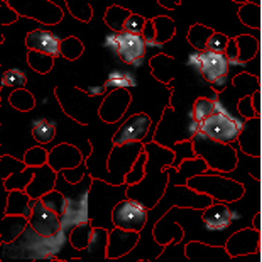
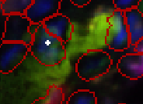
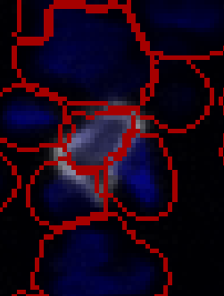
CD8
1. Calling adjacent cell positive
2. Positive identification of 1 cell but 2 positive cells present
3. Background/nonspecific staining
3. Bleedthough/ background/ nonspefic staining in 520
Another positive cell missed on this image
1. Can adjust algorithm to not call this cell positive
2. Shows that this cell is positive and distinct

